Slide 1
Mood Board

Slide 2
User Stories
Story Begin: Workflows / Goals
Technology Interaction
End of Story: Goal Achieved?
1
View: Sally
Objective: Make food out of leftover ingredients.
Goal: Use all ingredients in the most effective way.
Output / End of Story
Sally found perfect recipe to use all ingredients she has and made food using cookpad app.
2
View: Sally
Objective: Learn new recipes using the surprise me option.
Goal: Find a new recipe she has never tried before.
Output / End of Story
Sally learned about new recipe which she found from using surprise me option.
3
View: Savanah
Objective: Discover new recipes in line with her dietary restriction.
Goal: Have new vegan recipes for her Instagram.
Output / End of Story
Savanah learned about new vegan recipes and also explored more options to have in her repertoire of recipes.
User Story (interaction) in 7 seconds
Inputs
Outputs

Slide 3
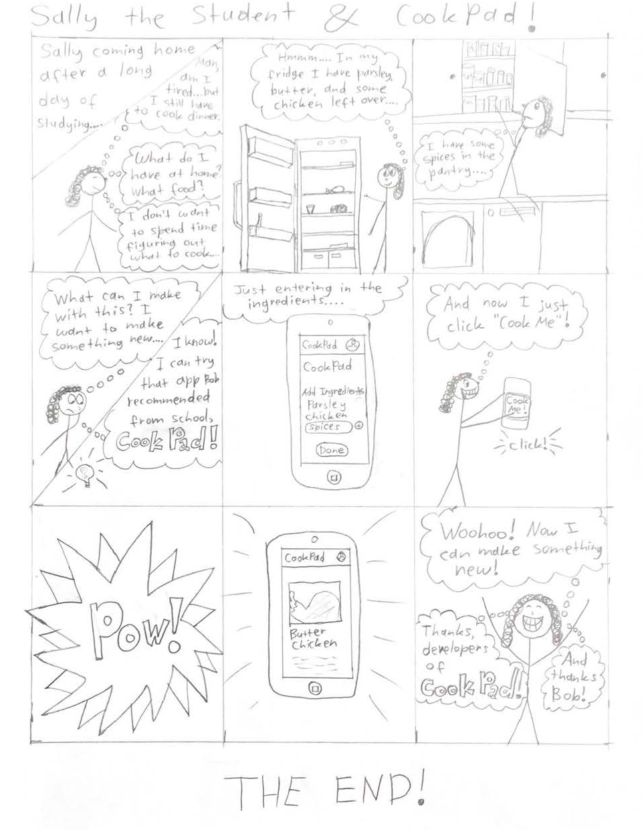
User Story 3 Workflow Script
Information Architecture
This is the main CookPad page. The user inputs in some ingredients (using the input box, and adding new ingredients using the plus on the side of the input box) and then clicks Done. The user is then taken to a list of scrollable recipes.
Ingredients
Food items
Food recipes
ingredients
Recipe steps
Food images

Slide 4
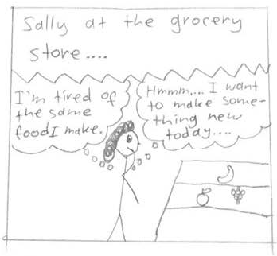
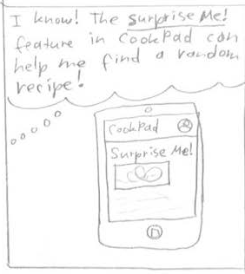
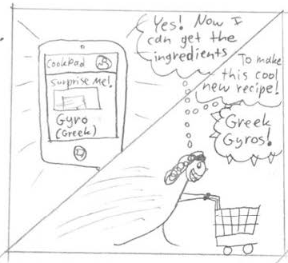
User Story 1 Workflow Script
Information Architecture
This is the Surprise Me! Page. When users click on the Surprise Me! button (from User Story 3), it will take them to this page, where they will receive a randomly-generated recipe.
Surprise Me! Page
CookPad back button
Recipes
Images
Recipe steps

Slide 5
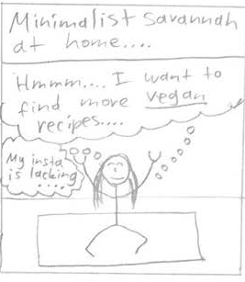
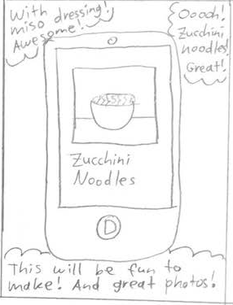
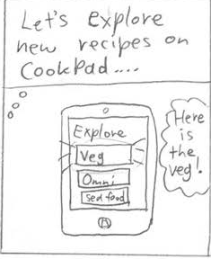
User Story 2 Workflow Script
Information Architecture
This is the Explore New Recipes page. Users have the option of selecting from different dietary categories of recipes using the labelled buttons on the page.
Each button takes the user to a page where a bunch of recipes are listed, which the user can scroll through.
Note: Add in vegan(?), carnivore(?)
Note 2: Add page of scrolling through recipes
Explore new recipes page
CookPad back button
Vegetarian button
Non-Vegetarian button
Seafood button
Fast food button

Slide 6
Information Architecture
Information Architecture
Shows your information architecture at a glance
Include all of the information architectures used within each of the previous workflows / stories. This is used by others within your development team to build or design the underlying data model and for you to understand the relationship of the data and presentation into information at the highest level of the design
Ingredients
Food items
Food recipes
ingredients
Recipe steps
Food images
Surprise Me! Page
CookPad back button
Recipes
Images
Recipe steps
Explore new recipes page
CookPad back button
Vegetarian button
Non-Vegetarian button
Seafood button
Fast food button

